Slide 1
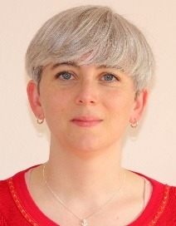
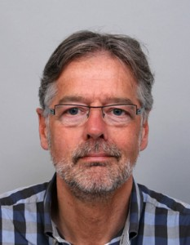
The LINGUISTIC VALIDATION of THE GUT FEELINGS QUESTIONNAIRE INTO THREE EUROPEAN LANGUAGES: an INTRIGUING PROCESS
Separate and independent forward translation by two native speakers into the intended language.
Separate and independent backward translation of the two results as obtained from step n°1 by two English native speakers.
First consensus version of the questionnaire obtained after comparison of the versions resulting from step N°1 and 2 by the research team.
Cultural validation of the questionnaire by GPs asked to check grammatical errors and cultural misunderstandings.
Second consensus with the summary of the GPs’ comments and suggestions for modifications submitted to the four translators and the research team.
Last consensus and definitive version of the questionnaire in the intended language.
BACKGROUND
Incidental gut feelings in general practice have been described, namely, as “a sense of alarm” and “a sense of reassurance”.
A Dutch Gut Feelings Questionnaire (GFQ) was developed, validated and afterwards translated into English following a linguistic validation procedure.
Step 1
AIMS
to translate the Gut Feelings Questionnaire (GFQ) from English into French, German and Polish;
to describe uniform elements as well as differences and difficulties in the linguistic validation processes
to propose a uniform procedural scheme for future GFQ translations
Step 2
RESULTS
12 translators
52 GPs
8 researchers in the field
participated in the study from
France, Germany, Switzerland and Poland.
The collaborating research teams created three versions of the 10-item GFQ.
Similar items generated discussions in the three different research teams. Expressions such as “uneasy feeling” and “wait and see” do not correspond to existing linguistic concepts in French, German or Polish but may be reflected in analogy.
The GFQ was modified to correspond to French, Polish and German systems.
Step 3
Step 4
Step 5
CONCLUSION
The Gut Feelings Questionnaire (GFQ) is now available in five European languages: Dutch, English, French, German and Polish. Comparing results of research into the predictive value of gut feelings in several European countries, where the native language is one of these five, is now possible.
Step 6
Marie Barais, Slawomir Czachowski, Daniel Hausmann, Johannes Hauswaldt, Agnieszka Sowinska,
Paul van Royen and Erik Stolper.

